Slide 1
Task description
Agile Development Processes 2015
Eric Knauss

Slide 2
Agile Principles and Practices
Goal: Try them out in your project!
 | Mandatory | Optional | Comment
Planning Game | 1 | 0 | Make the most out of it. Get Emil's Priorities based on your effort estimation. Employ customer proxy
Small Releases | 1 | 0
Metaphor | 0 | 1 | Try it out! But we will not check whether it works.
Simple Design | 1 | 0
Test-First | 1 | 0 | But only where it makes sense. Have a good rationale!
Refactoring | 1 | 0
Pair Programming | 0,5 | 0,5 | Try it out. Don't necessarily do it all the time.
Collective Codeownership | 2 | 0 | Everybody should know about the code. Some parts more than others
Continuous Integration | 1 | 0
Sustainable Pace | 1 | 0 | But also not too slow!
Onsite Customer | 0,5 | 0,5 | Have a customer proxy
Coding standards | 1 | 0 | Decide on them and try to have tool support

Slide 3
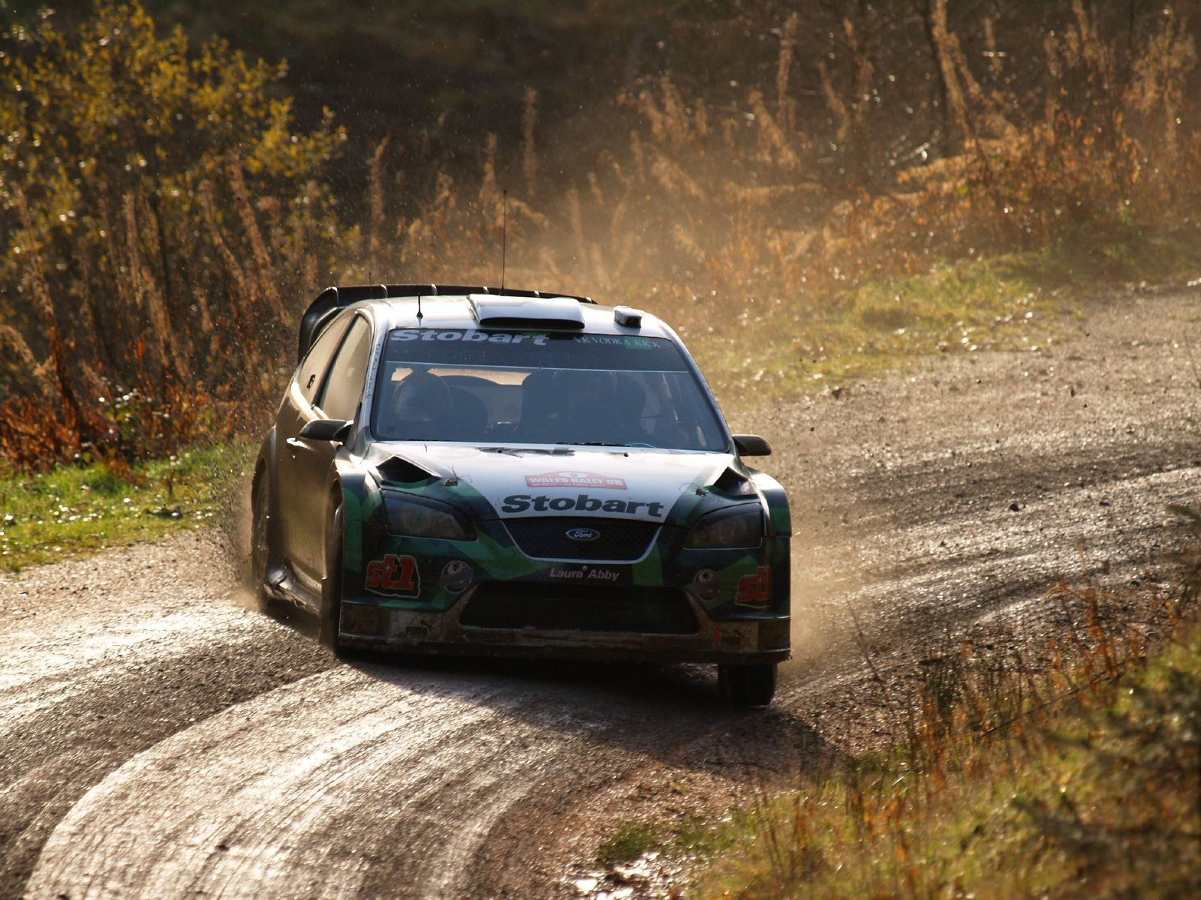
Pair programming
Navigator
Driver
Task
http://upload.wikimedia.org/wikipedia/commons/b/bd/Jari-Matti_Latvala-2007_Wales_Rally_GB_001.jpg

Slide 4

We know the tools of the driver…
https://flic.kr/p/77rfcL

Slide 5
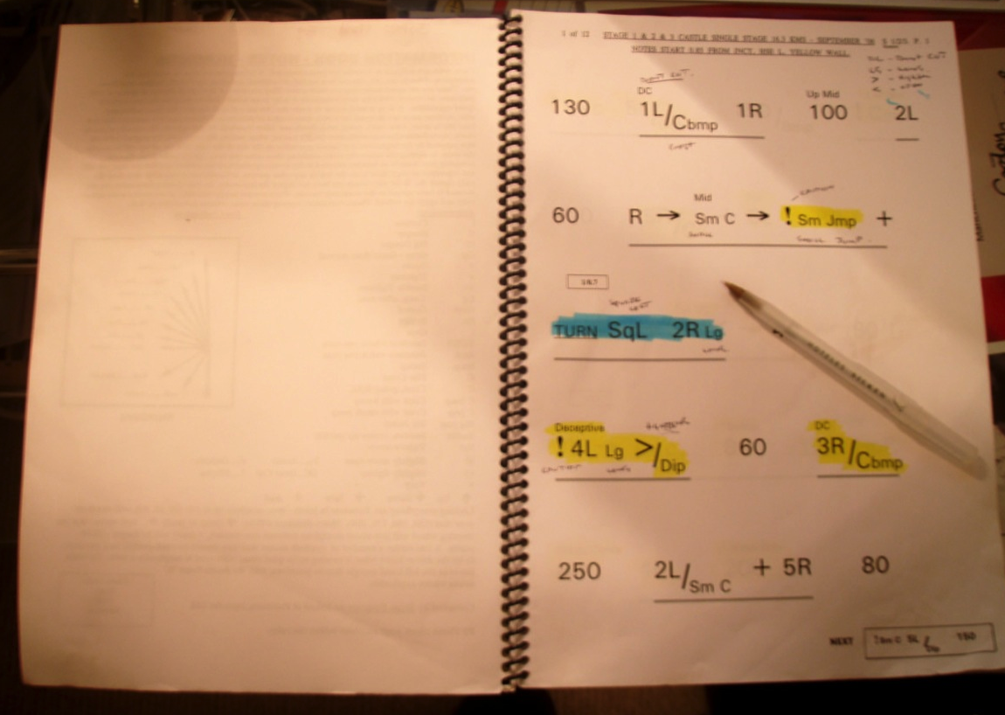
It is time to take care of the navigator…
http://en.wikipedia.org/wiki/File:Pacenotes.jpg

Slide 6
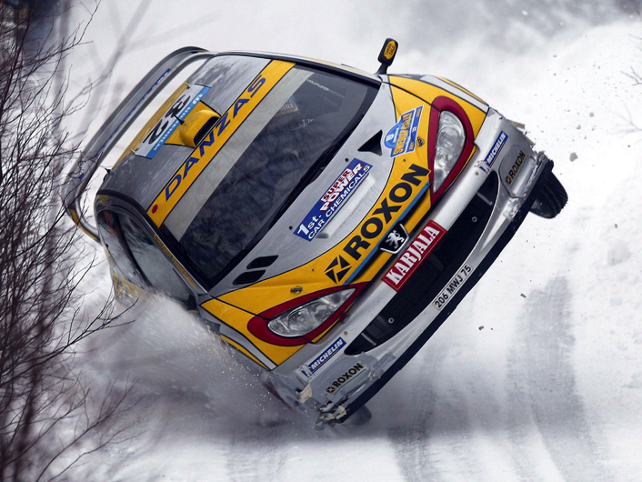

Task: Pair Programming Pacenotes
Rally
Pair Programming
http://civic.mit.edu/blog/natematias/pair-research-low-fi-tools-for-collaboration-in-teams
http://en.wikipedia.org/wiki/File:Peugeot_206_WRC.jpg
Primary
Know state of master branch
Know position of other team-members
Primary
Know road conditions
Know position of other teams
Secondary
Prepare for track
Measure/analyze performance
Secondary
Support planning game
Measure/analyze velocity

